Slide 1
Chapter 6: Inventories
Financial & Managerial Accounting, 16e

Slide 2
Safeguarding Inventory
Controls for safeguarding inventory begin as soon as the inventory is ordered.
The following documents are often used for inventory control:
The purchase order authorizes the purchase of the inventory from an approved vendor.
The receiving report establishes an initial record of the receipt of the inventory.
The vendor’s invoice
The subsidiary inventory ledger provides a record of the amount of inventory available and helps keep inventory quantities at proper levels.
Controls for safeguarding inventory should include security measures to prevent damage and customer or employee theft.
Notes:
Some examples of security measures include the following:
Storing inventory in areas that are restricted to only authorized employees
Locking high-priced inventory in cabinets
Using two-way mirrors, cameras, security tags, and guards

Slide 3
Reporting Inventory
A physical inventory or count of inventory should be taken near year-end to make sure that the quantity of inventory reported in the financial statements is accurate.
After the quantity of inventory on hand is determined, the cost of the inventory is assigned for reporting in the financial statements.

Slide 4
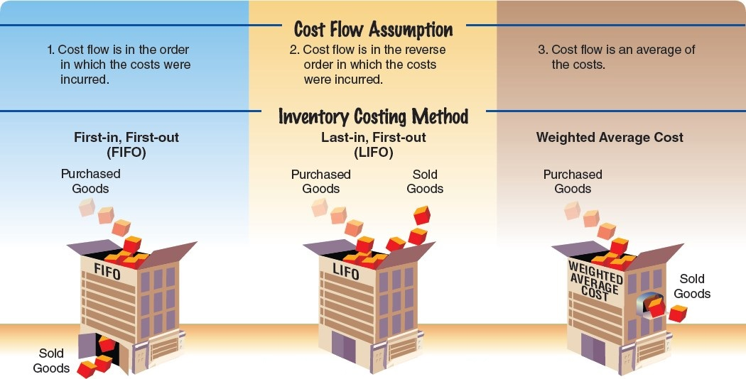
Exhibit 1 – Cost Flow Assumptions

Slide 5
Inventory Cost Flow Assumptions
Assume that three identical units of merchandise are purchased during May, as follows:
 |  |  | Units | Cost
May | 10 | Purchase | 1 | $ 9
 | 18 | Purchase | 1 | 13
 | 24 | Purchase | 1 | 14
Total |  |  | 3 | $36

Slide 6
Inventory Cost Flow Assumptions (
Assume that one unit is sold on May 30 for $20. Depending upon which unit was sold, the gross profit varies from $11 to $6, computed as follows:
 | May 10 Units Sold | May 18 Units Sold | May 24 Units Sold
Sales | $20 | $ 20 | $ 20
Cost of goods sold | (9) | (13) | (14)
Gross profit | $11 | $ 7 | $ 6
Ending inventory | $27 | $ 23 | $ 22
 | ($13 + $14) | ($9 + $14) | ($9 + $13)

Slide 7
Inventory Cost Flow Assumptions (4 of 4)
Under the specific identification inventory cost flow method, the unit sold is identified with a specific purchase. The ending inventory is made up of the remaining units on hand.
Under the first-in, first-out (FIFO) inventory cost flow method, the first units purchased are assumed to be sold and the ending inventory is made up of the most recent purchases.
Under the last-in, first-out (LIFO) inventory cost flow method, the last units purchased are assumed to be sold and the ending inventory is made up of the first purchases.
Under the weighted average inventory cost flow method, sometimes called the average cost flow method, the cost of the units sold and in ending inventory is a weighted average of the purchase costs.
The purchase costs are weighted by the quantities purchased at each cost, thus the term weighted average.

Slide 8
Inventory Costing Methods Under a Perpetual Inventory System (Learning Objective 3)
The FIFO, LIFO, and weighted average cost methods are illustrated under a perpetual inventory system.
For purposes of illustration, the following data for Item 127B are used:
 |  | Item 127B | Units | Cost
Jan. | 1 | Inventory | 1,000 | $20.00
 | 4 | Sale at $30 per unit | 700
 | 10 | Purchase | 500 | 22.40
 | 22 | Sales at $30 per unit | 360
 | 28 | Sales at $30 per unit | 240
 | 30 | Purchase | 600 | 23.30

Slide 9
Perpetual Inventory System: First-In, First-Out Method (1 of 2)
When the FIFO method is used, costs are included in the cost of goods sold in the order in which they were purchased.
This is often the same as the physical flow of the goods.
Thus, the FIFO method often provides results that are about the same as those that would have been obtained using the specific identification method.
Print Item
FIFO reports the most current prices in ending inventory is

Slide 10
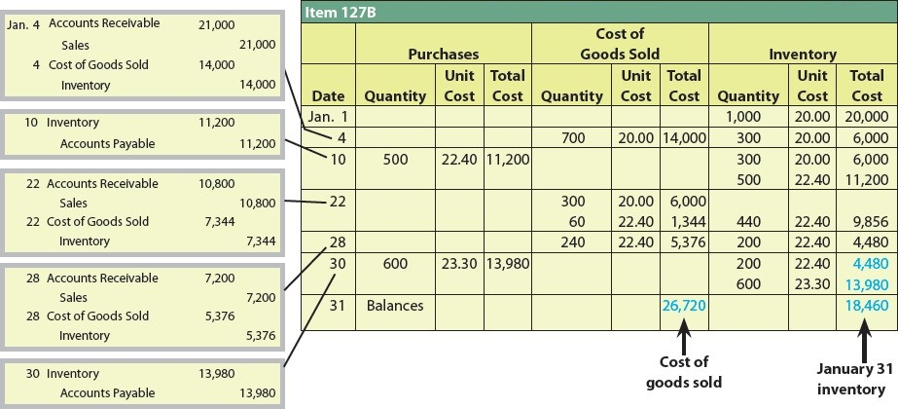
Exhibit 3 – Entries and Perpetual Inventory Account (FIFO)

Slide 11
Perpetual Inventory System: First-In, First-Out Method (2 of 2)
The ending balance on January 31 is $18,460. This balance is made up of two layers of inventory as follows:
 | Date of Purchase | Quantity | Unit Cost | Total Cost
Layer 1: | Jan. 10 | 200 | $22.40 | $ 4,480
Layer 2: | Jan. 30 | 600 | 23.30 | 13,980
Total |  | 800 |  | $18,460

Slide 12
Perpetual Inventory System: Last-In, First-Out Method (1 of 2)
When the LIFO method is used, the cost of the units sold is the cost of the most recent purchases.
The LIFO method was originally used in those rare cases where the units sold were taken from the most recently purchased units.
For tax purposes, LIFO is now widely used even when it does not represent the physical flow of units.
When the LIFO method is used, the subsidiary inventory ledger is sometimes maintained in units only.
The units are converted to dollars when the financial statements are prepared at the end of the period.
LIFO assigns the most recent costs to cost of goods sold

Slide 13
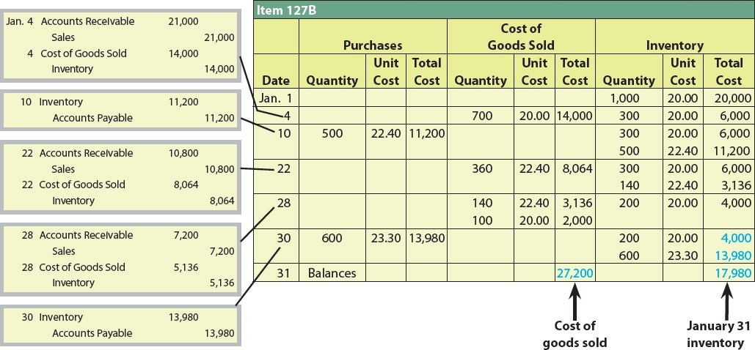
Exhibit 4 – Entries and Perpetual Inventory Account (LIFO)

Slide 14
Perpetual Inventory System: Last-In, First-Out Method (2 of 2)
The ending balance on January 31 is $17,980. This balance is made up of two layers of inventory as follows:
 | Date of Purchase | Quantity | Unit Cost | Total Cost
Layer 1: | Beg. inv. (Jan. 1) | 200 | $20.00 | $ 4,000
Layer 2: | Jan. 30 | 600 | 23.30 | 13,980
Total |  | 800 |  | $17,980

Slide 15
Knowledge Check Activity 1
Which of the following inventory costing methods would be associated with the highest cost of goods sold expense on the income statement, assuming a period of rising costs?
FIFO (first-in, first-out)
Specific identification
LIFO (last-in, first-out)
Weight average cost

Slide 16
Knowledge Check Activity 1: Answer
Which of the following inventory costing methods would be associated with the highest cost of goods sold expense on the income statement, assuming a period of rising costs?
Answer: c. LIFO (last-in, first-out)
Assuming a period of rising costs, the latest purchased inventory items would have the highest costs, so when those are chosen first to build or sell products in a company, they will have the highest cost of goods sold. The older items, presumably purchased at a lower cost, would remain in the inventory account on the balance sheet.

